Slide 1
Q1 2022 Market Update

Slide 2
Surcharges & Base Price Outlook
Nickel is up over 33% since August. It is now over $11/LB. See attached slide 4.
The continued growth of electric cars is having an impact. Sales of Tesla and other EV’s is strong.
Strength from Worldwide Stainless usage remains strong. LME stock levels are low. See attached slide 5.
Base prices continue to increase. NAS has had three since Sept. 21.
EU mills have instituted an Energy Surcharge in addition to raw material surcharges. These are in the .15/lb. range.
Container costs from India & China remain high. We have the Chinese Export Tax, 232, and section 301 all still in place.

Slide 3
1Q 2022 Increases by Alloy
Alloy | Surcharge Increase 1Q 2022 | April Estimated Additional Increase | Total Est Increase 12-31-21 --> 4-30-21 Including Base Increase
17-4 | $0.07 | $0.08 | $0.20
201/204 | $0.07 | $0.05 | $0.17
302HQ | $0.18 | $0.17 | $0.40
303 | $0.16 | $0.11 | $0.32
304 | $0.15 | $0.11 | $0.31
310/314 | $0.40 | $0.29 | $0.74
316L | $0.24 | $0.13 | $0.42
416 | $0.00 | $0.00 | $0.05
430 | $0.00 | $0.00 | $0.05
35/19cb | $0.97 | $0.58 | $1.55
A286 | $0.66 | $0.40 | $1.06
M400 | $1.37 | $0.82 | $2.19
N600 | $1.60 | $0.96 | $2.56
N601 | $1.24 | $0.74 | $1.98
718 | $1.25 | $0.75 | $2.00

Slide 4
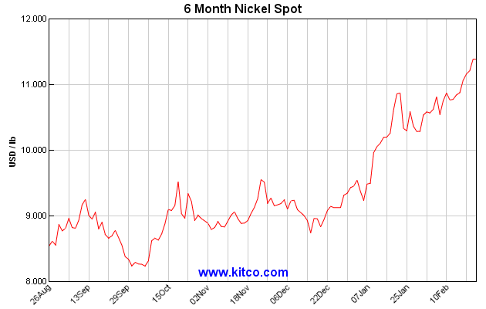

Slide 5
